Slide 1
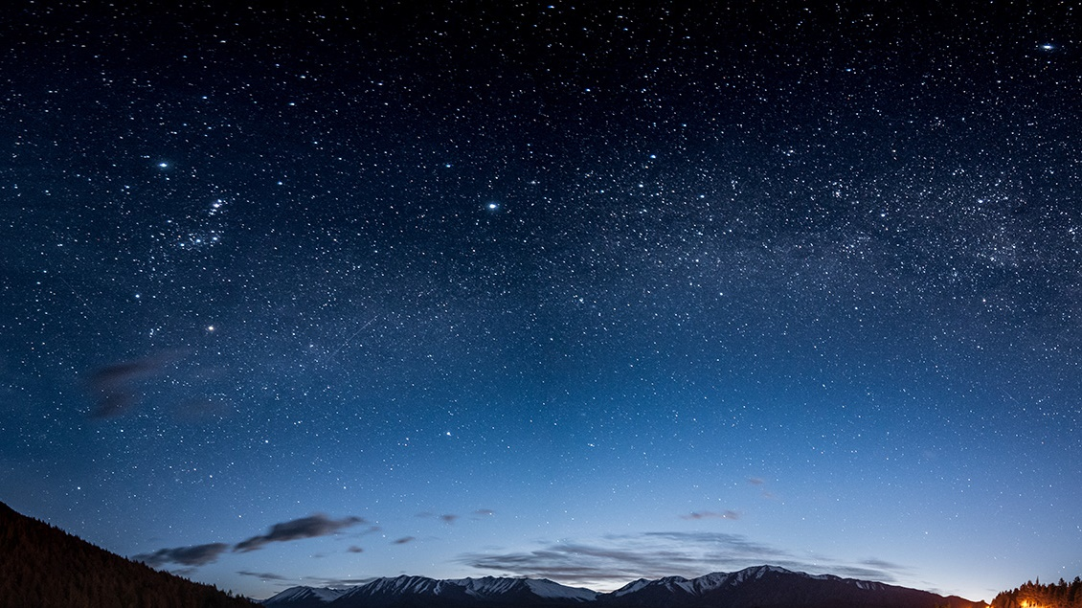
IMAGE CAPTION GENERATOR
SMART INTERNZ AI EXTERNSHIP

Slide 2
TEAM
SANTHOSH NARAYANAN 20BCE1309 VIT CHENNAI
TATHAGATA BISWAS 20BCE1844 VIT CHENNAI
NARASAMBATTU SRI SISHVIK 20BCE1735 VIT CHENNAI
KARTHEEK ANUSURI 20BAI10344 VIT BHOPAL

Slide 3
INTRODUCTION
Image caption generation is a challenging task in the field of computer vision and natural language processing. It involves the generation of human-like descriptions or captions for given images. This report presents a deep learning-based approach to tackle the image caption generation problem.

Slide 4
OBJECTIVE
The objective of this study is to develop a system that can automatically generate captions for images using a pre-trained deep learning model. The system allows users to upload images through a web interface and provides captions describing the content of the images.

Slide 5
METHODOLOGY
The system is implemented using the Flask framework, a popular web application framework in Python. A pre-trained image captioning model is loaded and used to generate captions for the uploaded images. The model utilizes convolutional neural networks (CNNs) for image feature extraction and recurrent neural networks (RNNs) for generating captions based on the extracted features.

Slide 6


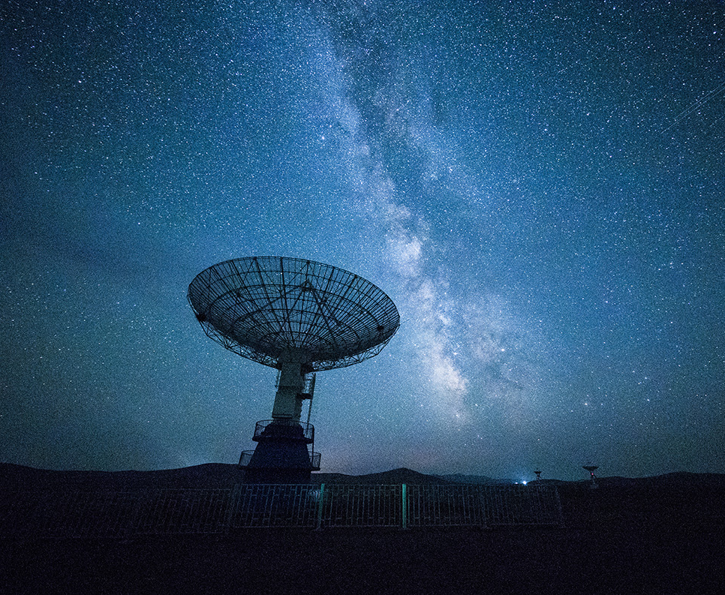
KEY COMPONENTS
Model Loading
Image Preprocessing
Caption Generation
Web Interface

Slide 7
RESULT
The system demonstrates the effectiveness of deep learning techniques in generating meaningful captions for a variety of images. The generated captions provide descriptive information about the content of the uploaded images. The system allows for multiple image uploads, making it convenient for users to generate captions for multiple images simultaneously.

Slide 8
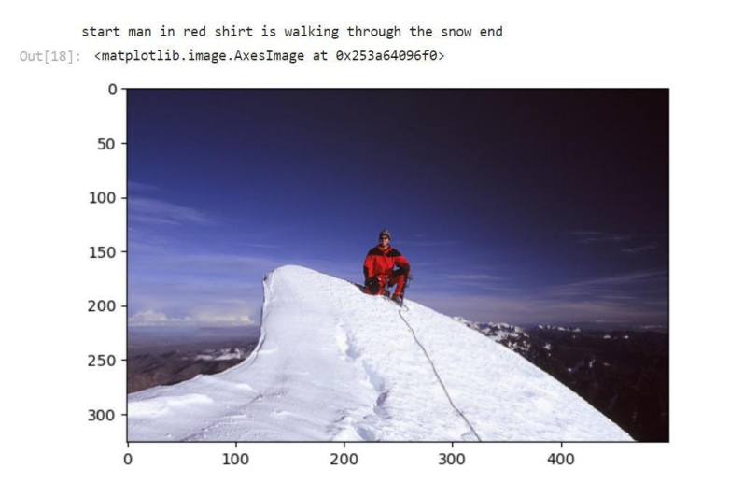
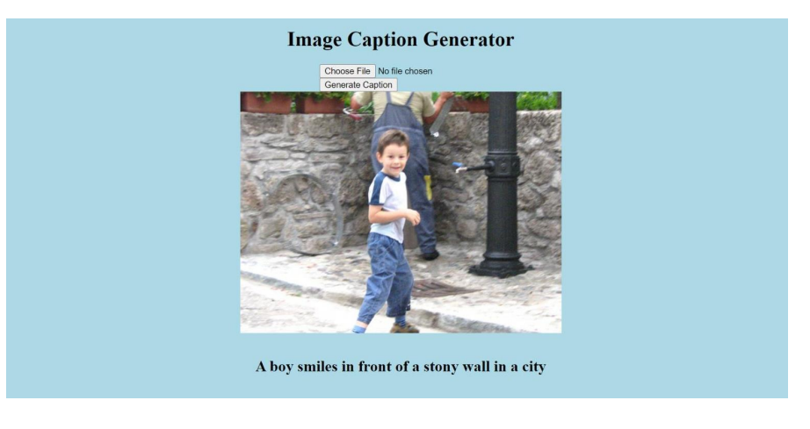
CAPTION GENERATION
WEB INTERFACE

Slide 9
CONCLUSION
Image caption generation is a complex task that requires combining computer vision and natural language processing techniques. The developed system successfully generates captions for uploaded images using a pre-trained deep learning model. The system showcases the potential of deep learning in understanding and describing the content of images. Further enhancements and refinements can be explored to improve the accuracy and diversity of the generated captions.

Slide 10

Thank You!
someone@example.com

